Slide 1

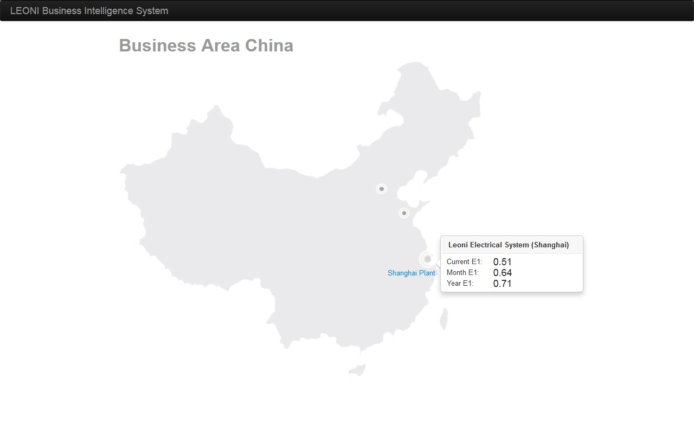
Screen 1

Slide 2
Short description of screen 1
First screen of the application
Show the E1 overview of a certain plant when you touch the point representing the plant
Touch the button to view details of a plant

Slide 3
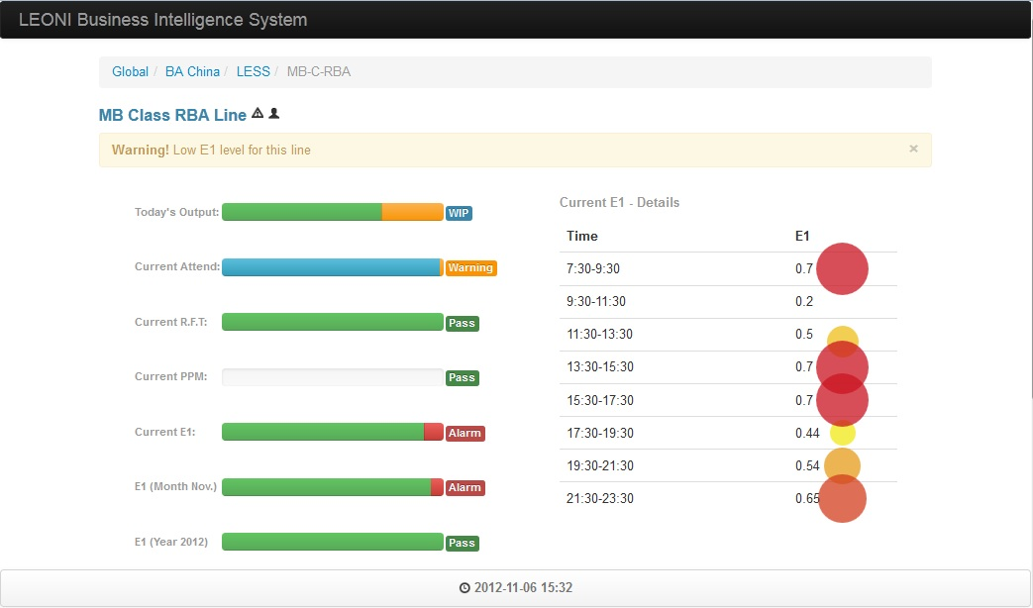
Screen 2

Slide 4
Short description of screen 2
First row: the production line ID
Row 2: Some instant notification
Row 3 Column 1: The KPI indicator, indicate the percentage of the target and current value. Warning and alarm will be indicated beside the progress bar.
Row 3 Column 2: More details of the KPI indicator. For this screen shoot, it’s a tendency bubble diagram of current E1

Slide 5
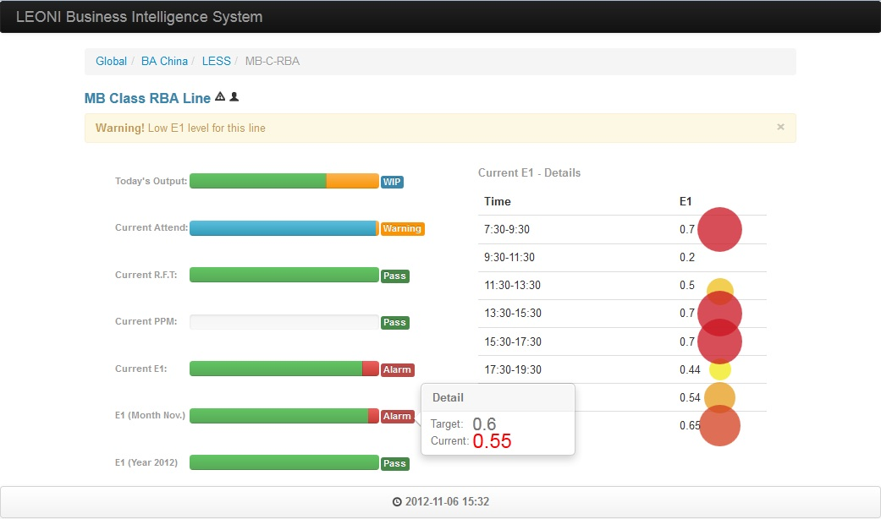
Screen 3

Slide 6
Short description of screen 3
When touch the progress bar, the target and current value is presented.

Slide 7
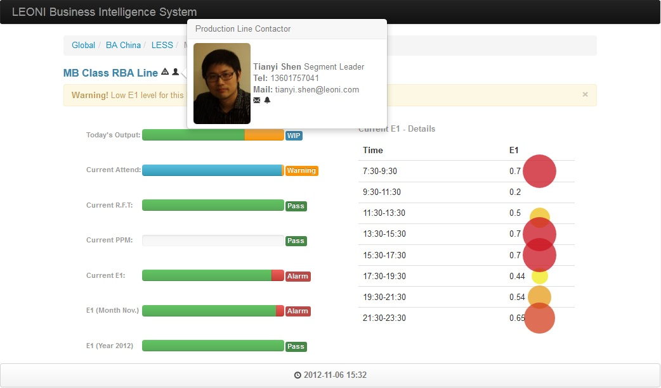
screen 4

Slide 8
Short description of screen 4
To get the contact information of the responsible person for current production line, simply touch the user icon beside the production line id

